Slide 1
WELCOME TO
1

Slide 2
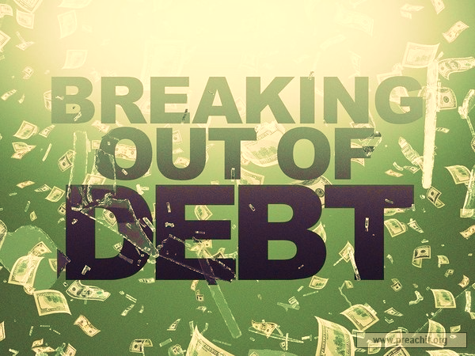
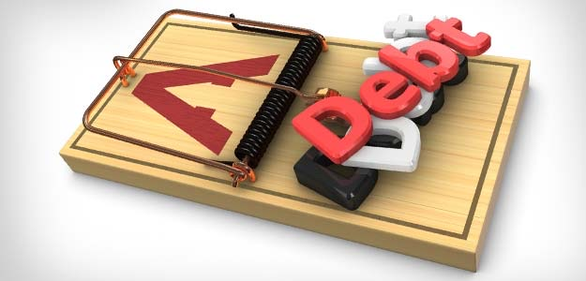

Slide 3
A culture
based on
instant
gratification

Slide 4
Consumer debt in the united states stands at nearly 2 trillion dollars

Slide 5
“What is God’s way
out of the debt trap?”

Slide 6
Why is debt a trap?

Slide 7
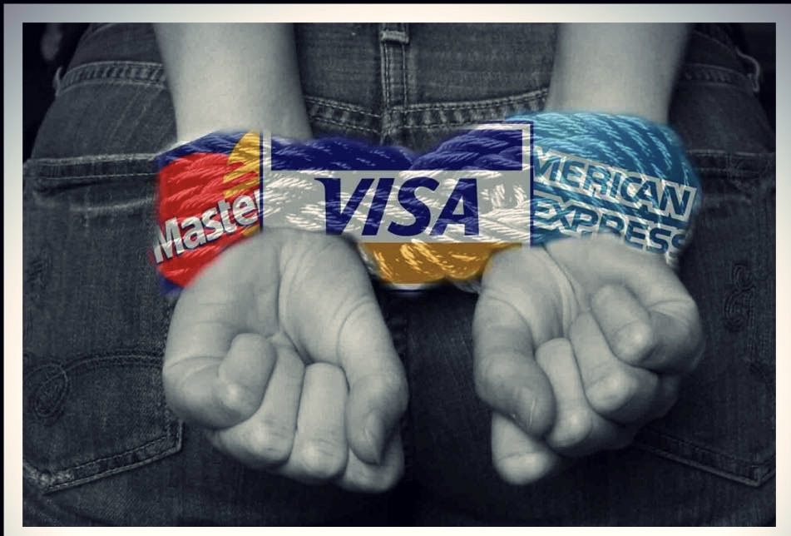
Proverbs 22:7
The rich ruleth over the poor, and the borrower is servant to the lender.

Slide 8
DEBT!

Slide 9
synonyms for debt
owe, obligated, liable, in deficit, in default, insolvent, encumbered, in over your head, tied up, out of pocket, in arrears, indigent, destitute, penniless, needy, lacking, distressed, in difficulty, a deadbeat, having the wolves at your door, living hand to mouth, empty, ruined, impoverished, bad off, beaten down, reduced to ruin, fleeced, stripped, reduced, unable to make ends meet, embarrassed, broke and busted.

Slide 10
Living on CREDIT
instead of PAYING CASH.

Slide 11
Proverbs 3:27 (LB)
Don't withhold repayment of your debts. Don't say "some other time," if you can pay now.

Slide 12
2. Delaying PAYMENTS
or paying the MINIMUM DUE.

Slide 13
Unable to
TITHE
or
SAVE.

Slide 14
4. Unable to PAY TAXES.

Slide 15
5. Extravagant SPENDING.

Slide 16
6. Looking for GET-RICH-QUICK ideas.

Slide 18
WELCOME TO
18

Slide 21
Why is debt a trap?

Slide 22
Proverbs 22:7
The rich ruleth over the poor, and the borrower is servant to the lender.

Slide 23
Living on CREDIT
instead of PAYING CASH.

Slide 25
2. Delaying PAYMENTS
or paying the MINIMUM DUE.

Slide 26
Unable to
TITHE
or
SAVE.

Slide 27
4. Unable to PAY TAXES.

Slide 28
5. Extravagant SPENDING.

Slide 29
6. Looking for GET-RICH-QUICK ideas.

Slide 31
8 specific steps

Slide 32
Commit yourself to becoming
DEBT FREE
now.

Slide 33
Psalm 37:21 (NIV)
The wicked borrow and do not repay, but the righteous give generously;

Slide 34
2. Start paying GOD and YOURSELF first.

Slide 35
Deuteronomy 14:23b (LB)
The purpose of tithing is to teach you always to put God first in your lives.
Proverbs 3:9 (LB)
Honor the Lord by giving him the first part of all your income, and he will fill your barns with wheat and barley and overflow your wine vats with the finest wines.

Slide 36
Malachi 3:10 (NLT)
Bring all the tithes into the storehouse so there will be enough food in my Temple. If you do," says the Lord Almighty, "I will open the windows of heaven for you. I will pour out a blessing so great you won't have enough room to take it in! Try it! Let me prove it to you!

Slide 37
1 Corinthians 16:2 (LB)
On every Lord's Day each of you should put aside something from what you have earned during the week, and use it for this offering. The amount depends on how much the Lord has helped you earn.

Slide 38
3. List everything you OWN and everything you OWE.

Slide 39
Proverbs 24:3 (LB)
Any enterprise is built by wise planning, becomes strong through common sense, and profits wonderfully by keeping abreast of the facts.
Proverbs 18:13 (LB)
What a shame--yes, how stupid!--to decide before knowing the facts!

Slide 40
Have a
SALE.

Slide 41
Ezekiel 20:7a (LB)
Get rid of every idol.

Slide 42
5. Set up a REPAYMENT plan.

Slide 43
Proverbs 20:18a (LB)
Don't go ahead with your plans without the advice of others.

Slide 44
6. Add no NEW DEBT.

Slide 45
Hebrews 13:5a (NIV)
Keep your lives free from the love of money and be content with what you have.

Slide 46
7. Share your plan with your CREDITORS.

Slide 47
Proverbs 16:7 (GW)
When a person's ways are pleasing to the Lord, he makes even his enemies to be at peace with him

Slide 48
STICK
TO IT!

Slide 49
Galatians 6:9 (LB)
And let us not get tired of doing what is right, for after a while we will reap a harvest of blessing if we don't get discouraged and give up.

Slide 50
Colossians 2:14 (IBC)
We owed a debt because we broke God’s laws. That debt listed all the rules we failed to follow. But God forgave us and took away that debt and nailed it to the cross.

